Slide 1
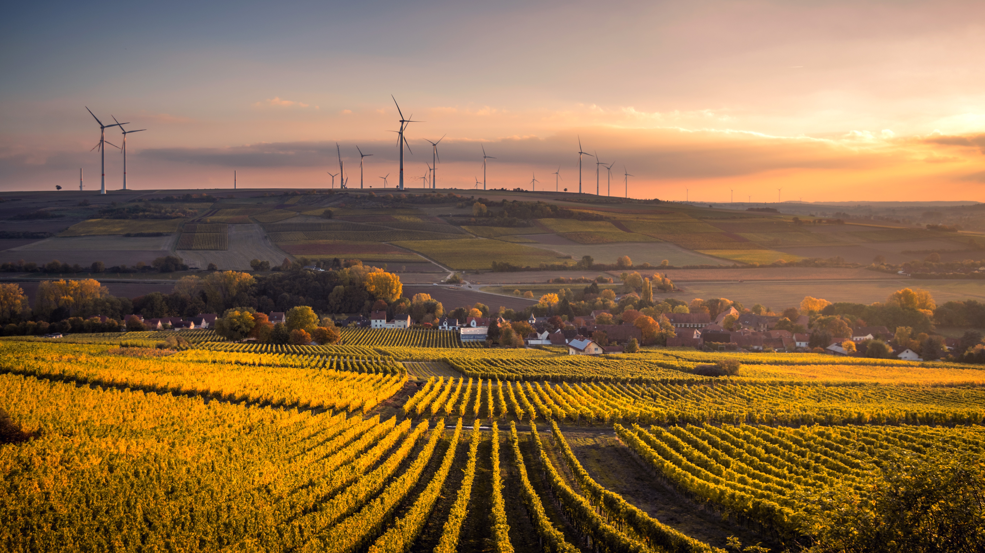
AN EXPLORATORY ANALYSIS OF THE DECISION MAKING OF ENERGY INVESTMENT IN INDUSTRIAL PARKS
Merih Koray Karabulut
Shajeeshan Lingeswaran
Yubin Cho

Slide 2
Research Question
What drives investors of industrial parks to make an investment decision in wind parks to self-supply their electricity demand?

Slide 3
Method
Simulation models vs Optimization models
Simulation tools → “what happens if …”
Optimization tools → “what is …”
Complexity of non-linear behaviour in optimization models
Convenience of projecting non-linearity in simulation models
Agent-based models
Time-tick based processing
ABM is specialized for:
Multi-actor structures
Interaction among the agents
Autonomous decisions of agents

Slide 4

Method

Slide 5

System Boundaries
Industrial Park
……
Regulator
Market
Investor
Technology
Geographic Condition

Slide 6
Model Narrative
Regulator
observe carbon emission in the system
Investor
buy electricity from grid if needed and thereby emit carbon
Regulator
check the ability to satisfy the target
Regulator
change the EEG subsidy respectively
Investor
add wind-park and storage if ROI is above individual threshold
quadrennial
Investor
calculate ROI based on EEG subsidy and the peer effect
yearly

Slide 7
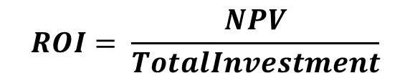
Investors – Detailed ROI calculations
Weighted Average Net CF (%) | Weighted Average CAPEX ($/kW) |  |  |  |  | Weighted Average OPEX ($/kW/yr) |  |  |  |  | Weighted Average Wind Speed (m/s)
 | 2016 | 2020 | 2030 | 2040 | 2050 | 2016 | 2020 | 2030 | 2040 | 2050
47.4% | 1529 | 1450 | 1304 | 1227 | 1219 | 51.331 | 49.854 | 46.161 | 42.468 | 38.775 | 8.7
46.2% | 1549 | 1472 | 1327 | 1251 | 1244 | 51.331 | 49.854 | 46.161 | 42.468 | 38.775 | 8.4
45.0% | 1559 | 1490 | 1360 | 1294 | 1292 | 51.331 | 49.854 | 46.161 | 42.468 | 38.775 | 8.2
43.5% | 1567 | 1502 | 1381 | 1320 | 1320 | 51.331 | 49.854 | 46.161 | 42.468 | 38.775 | 7.9
40.7% | 1585 | 1534 | 1442 | 1400 | 1407 | 51.331 | 49.854 | 46.161 | 42.468 | 38.775 | 7.5
36.4% | 1622 | 1596 | 1553 | 1542 | 1563 | 51.331 | 49.854 | 46.161 | 42.468 | 38.775 | 6.9
30.8% | 1669 | 1664 | 1665 | 1682 | 1715 | 51.331 | 49.854 | 46.161 | 42.468 | 38.775 | 6.2
24.6% | 1705 | 1715 | 1743 | 1777 | 1817 | 51.331 | 49.854 | 46.161 | 42.468 | 38.775 | 5.5
18.3% | 1735 | 1797 | 1931 | 2033 | 2103 | 51.331 | 49.854 | 46.161 | 42.468 | 38.775 | 4.8
11.1% | 1751 | 1849 | 2054 | 2201 | 2290 | 51.331 | 49.854 | 46.161 | 42.468 | 38.775 | 4.0
$$SUM of hourly load capacity$$
$$Policy lever:starting at 6.88 ct/KWh$$
$$NPV = Σ_{t∈T}\frac{AnnualEnergyConsumption\left(t\right)∗p_{eff}\left(t\right)−CAPEX −OPEX+AverageEnergySold\left(t\right)∗(p_{market}\left(t\right)+EEG)}{{\left(1+i\right)}^{t}}$$
$$Average annual effective market price$$
$$Average annual market price$$
Wind-Park capacity – AnnualEnergyConsumption
$$ROI= \frac{NPV}{TotalInvestment}$$

Slide 8
Investors – Peer Effect
Decision-making is often influenced by soft factors:
“act by habit, imitation of others, and trust in institutions, on reputation or a good name” (Gigerenzer and Engel, 2006, p.3)
Preference to stay with status quo instead of changing (Kahneman et. al, 1991)
Investor Types | Leader | Follower | Tradtionalist
ROI-Threshold | Low | Medium | High
Sensitivity to peers | Low | High | Low
$$ROIT=ROIT×STP ; \frac{Invested Investors}{Total number of investors} ≥STP$$

Slide 9
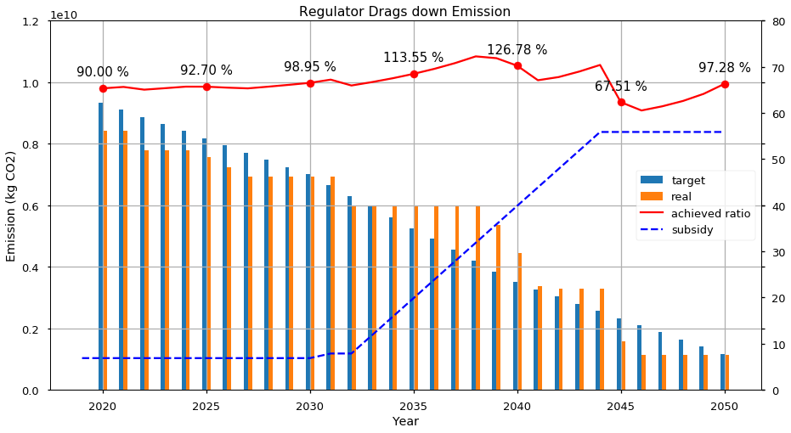
Model Verification (example) – How the Regulator interacts with the entire Emission level?

Slide 10
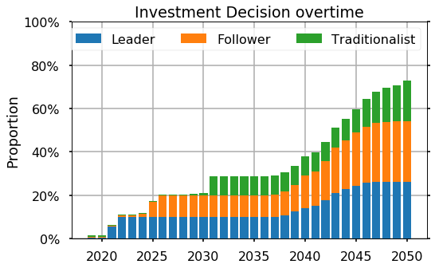
Result – Overview 1: Investments
Initiated by Leaders
Followers sharply increase after 2040
Technology becomes cheaper and Subsidy increases
Many investors participate in the Wind energy investment at the end

Slide 11
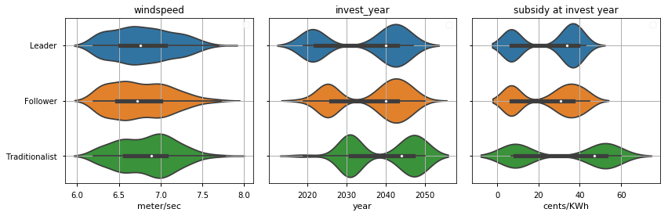
Result – Overview 2: Conditions
Average
6.79 m/s | Year 2036 | 26.99 cents/Kwh
All types have a large windspeed, compared to the Non-invested, 6.14m/s
The investment happens in a quite discrete fashion (1st, 2nd)
1st Phase: Investment only if they have a strong Windspeed
2nd Phase: Subsidy reaches to a certain point

Slide 12
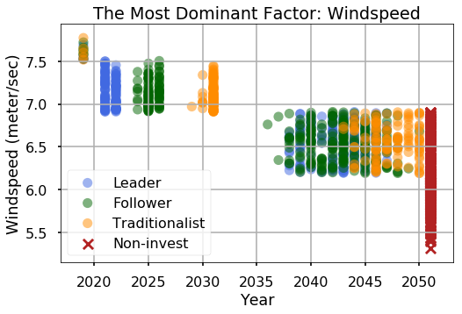
Result – Micro View 1: Windspeed
The stronger windspeed leads the more investment
1
Immediate Investment under sufficient Windspeed
More Investments as Subsidy increases, so does NPV
After 2035, the trend becomes lucid as the peer effect plays a role
Some non-investments despite of (seemingly) enough Windspeed
2
3
4

Slide 13
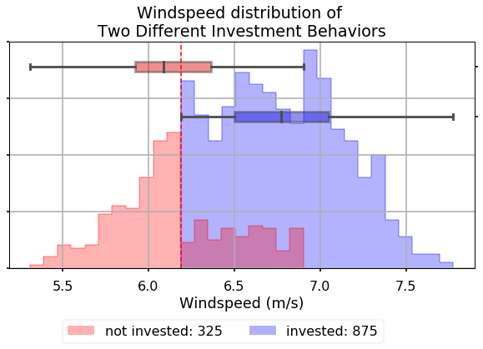
Result – Micro View 1: Windspeed
What is the minimum condition of the Windspeed?
No investment under 6.2 m/s
Why some investors don’t invest?
Capacity
Sensitivity
Subsidy
4

Slide 14
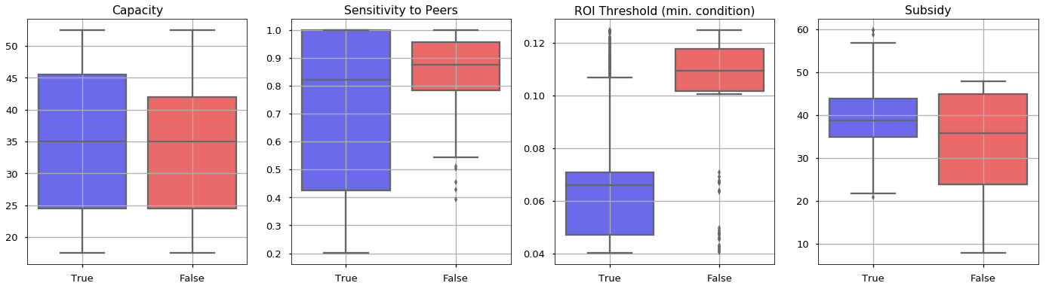
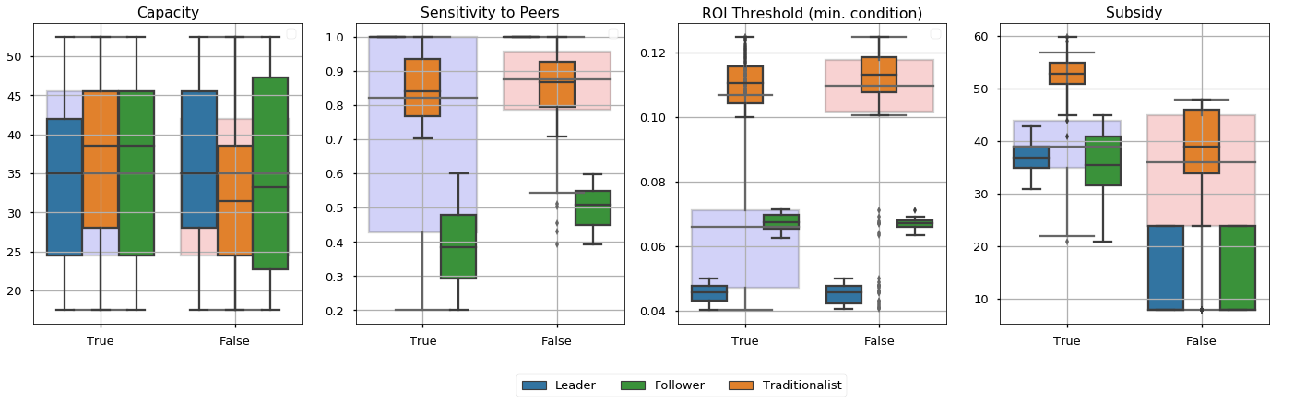
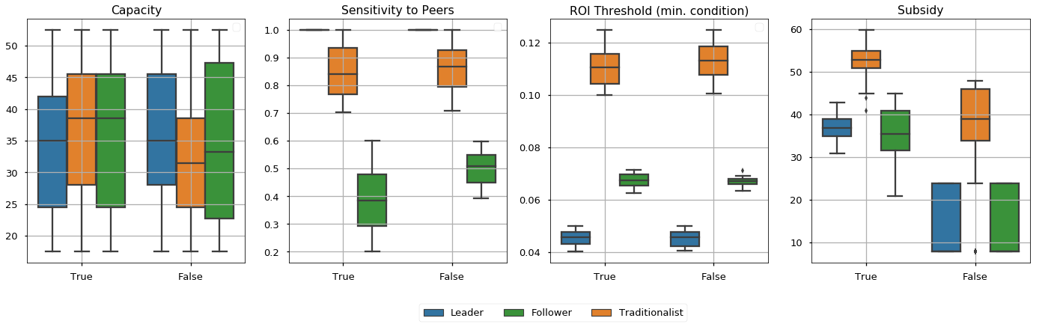
Result – Micro View 2: Subsidy
What still hinders the investment when the Windspeed is over 6.2m/s?
Each type of investors needs a certain amount of Subsidy to make an investment
Other factors seem to be less relevant to their behaviors

Slide 15
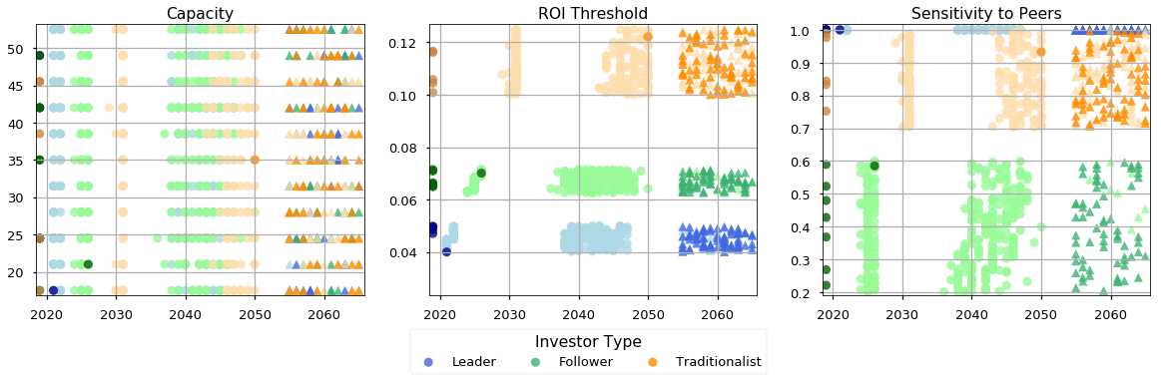
Result – Micro View 3: Other factors
Capacity, ROI Threshold, Sensitivity
Does the smaller threshold leads more invest? Or the more sensitive Investors make earlier investments? → Only holds for a certain group between 2020 and 2030
Lighter color indicates Insufficient Windspeed → Investment is delayed or not happened
Capacity is irrelevant

Slide 16
Conclusion
The investment is largely driven by Windspeed and Subsidy given the technological restriction.
The interaction among the agents (i.e. the investors’ peer effect) is significant, only for those who have sufficient Windspeed.
When the Windspeed is not strong enough, no one would make an investment regardless of the subsidy scale. (The same is not true in reverse.)
Subsidy may lead more investment, and yet the effects are limited

Slide 17
Extra Slides

Slide 18
Main Assumptions
The load is assumed to be daily.
All the short term operations, “generating, buying, selling, storing electricity”, are assumed to be done daily.
Wind speed is assumed to be distributed homogeneously in a province.
“Investment decision” and “getting affected by peers” are assumed to happen only once. Possible accumulations are kept out of the scope.
Carbon emission of industrial parks is assumed to be linearly correlated to Germany’s energy sector carbon emission values over the years.
Carbon emission of energy sector in Germany is assumed to be fixed at 560 gram CO₂/kWh electricity.
There is no upper bound for subsidies.
Linear forecasting methods are able to provide with quality results for this case.
Germany closely follows EU emission targets.
Either the green party, or a center party wins the elections with 50% chance.
Carbon emission of an industrial park is solely related to the amount of electricity it buys. The industrial activities within the park are out of scope.
The regulator focuses on the nearest emission target. It does not takes the longer period emission targets into account (e.g. if year is 2024, the regulator targets 2030, but not 2040 or 2050).

Slide 19
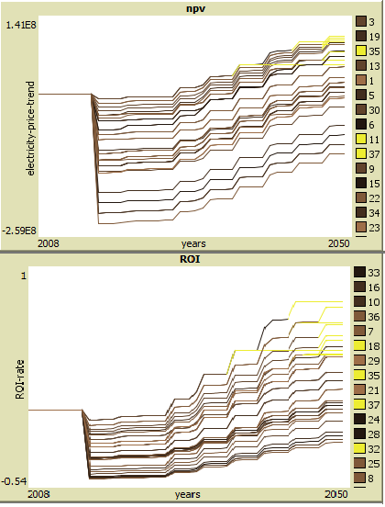
Investors
Investors’ main focus is on NPV & ROI calculations. Based on their values, they decide to make an investment, or not.
The numerical factors which are affecting these values:
“CAPEX”, “OPEX” and “Capacity Factor” values for assets (wind turbines, storages)
Market prices to sell electricity
Market prices to buy electricity
Discount rates
EEG related subsidies
The social factors which are affecting these values:
Investor type: “Leader, Traditionalist, Follower”
Type of an investor affects its perception towards the NPV expectations. It can also be considered as their perception of risk (Willingness to invest for low NPV = lower risk aversion)
Peer effect is another social determinant of investment decision. When investors see that the others are investing, they can have higher tendency to invest.

Slide 20
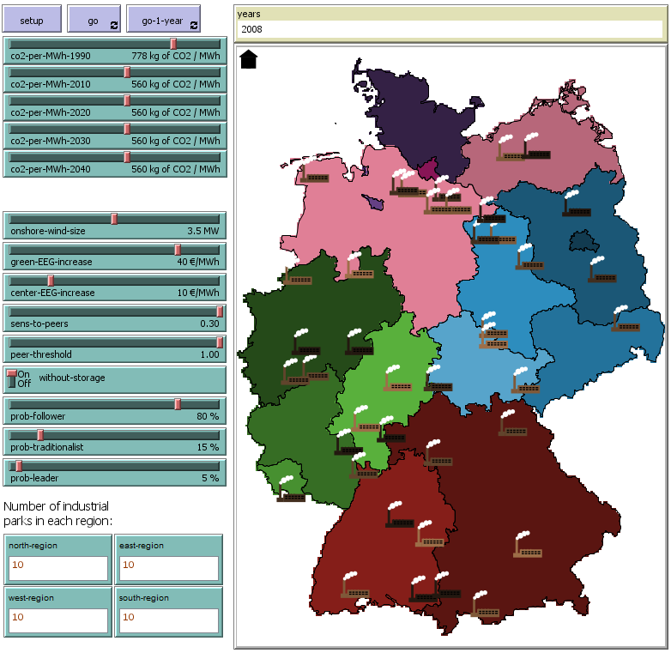
Method
Instead of an optimization focus, a simulation focus is applied.
No explicit objective function, no explicit constraints
Instead of answering “what is …?”, our model answers “what happens if …”
Then, by processing the output, inferences are made for the “what is …?” questions.
The model is separated into three sub-models
Regulator operations
Conducting elections
Calculating 1990 emission levels
Calculating target emission levels based on 1990 values
Storing carbon emission levels
Forecasting future emission performance
Investor long-term operations
Forecasting the market prices
Calculating NPV & ROI
Evaluating investment decisions
Investor short-term operations
Generating electricity
Buying / Selling electricity from / to the grid
Storing electricity
Calculating carbon footprint and informing the regulator about it
Then, these 3 parts are merged to model both strategic and operational decision making.
The electricity market is integrated as an external data source
Makes it possible to integrate an external optimization model as a market mechanism
Not implemented due to the computational constraints.

Slide 21
Regulator
Regulator is affecting the investment decision through a certain variable in NPV calculations of investors, “Subsidies”
The main focus for subsidies is the carbon emissions.
Regulator pursues certain emission targets over the years
It stores each years’ emission data
Based on the past years emission data, it extrapolates the future emission levels
If its predictions lead a failure to achieve the target levels, then it subsidizes the system to decrease the emission levels further.
If its predictions lead success, then it lets the system continue without any intervention.

Slide 22
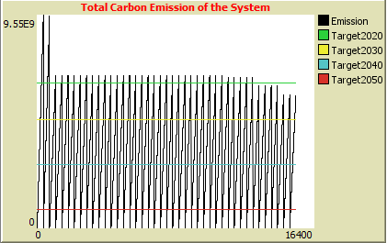
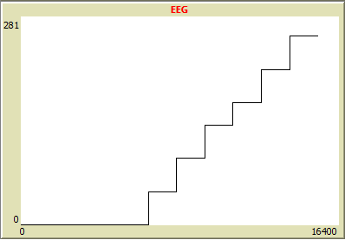
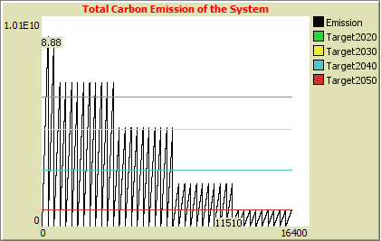
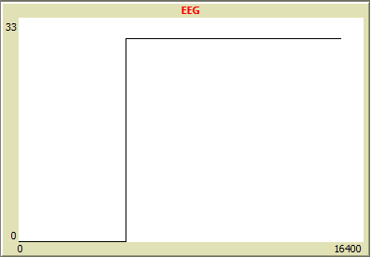
Regulator
Since the targets are not achieved, a lot of subsidy increase take place
Only 2020 emission target is missed, therefore the regulator tries reducing the emissions only at the beginning of the model.

Slide 23
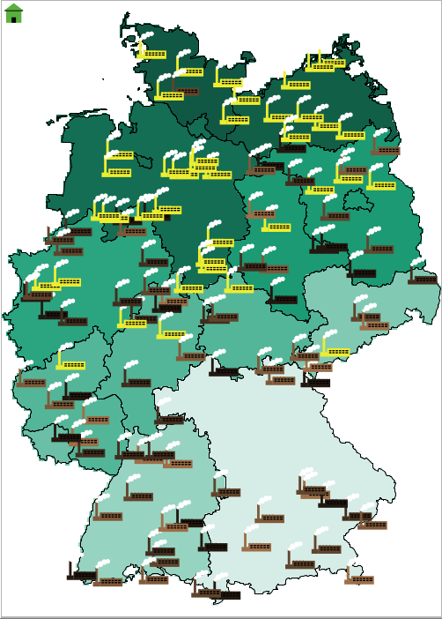
Environment
Environment is affecting the investment decision of investors critically, since the wind power is highly dependent on the geographical features.
Each “Bundesland” is identified on the map.
Average wind speed values are included in the model as a spatial attribute.

